Slide 1

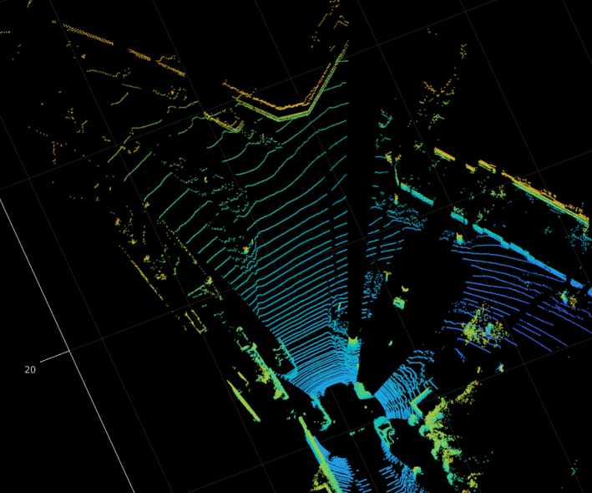
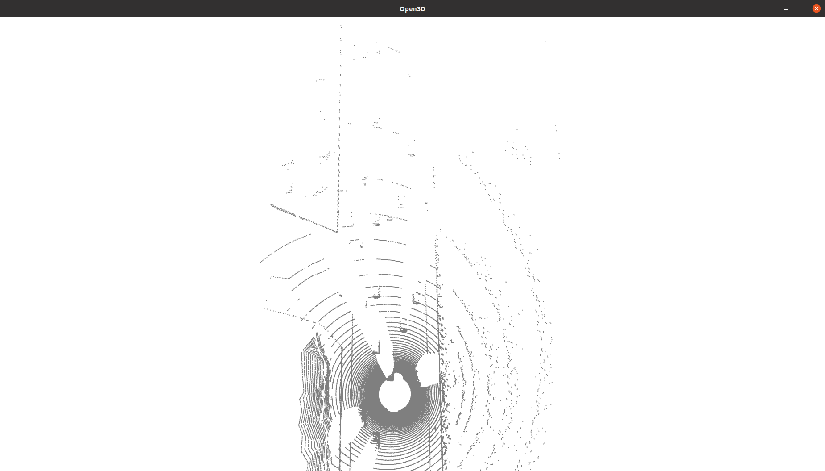
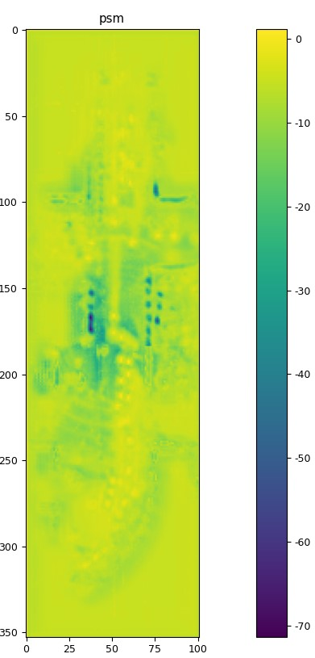
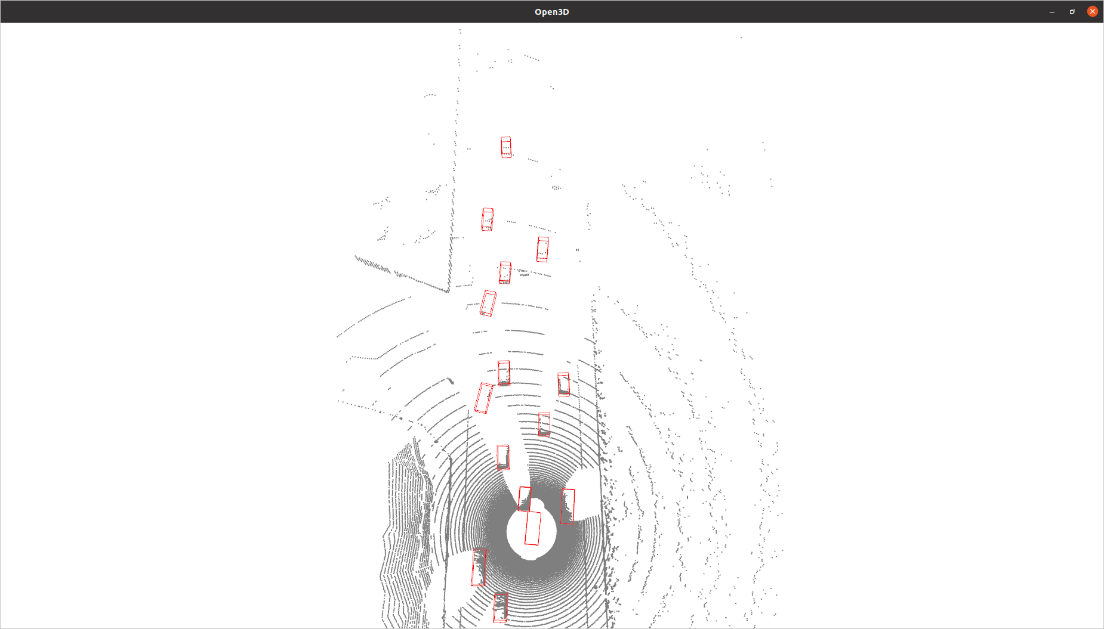
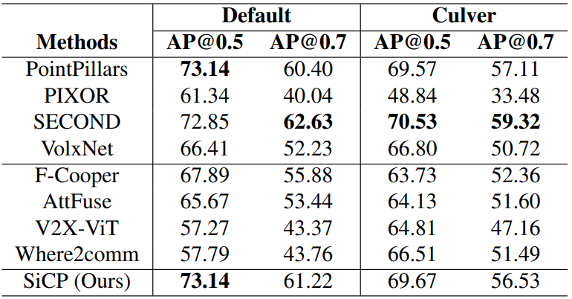
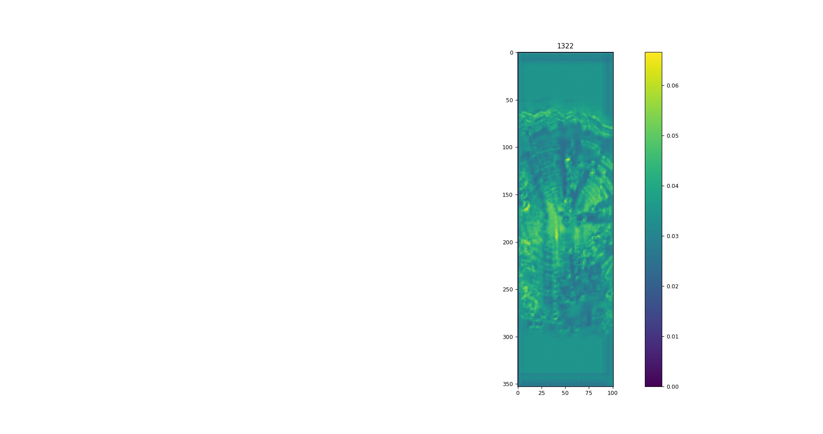
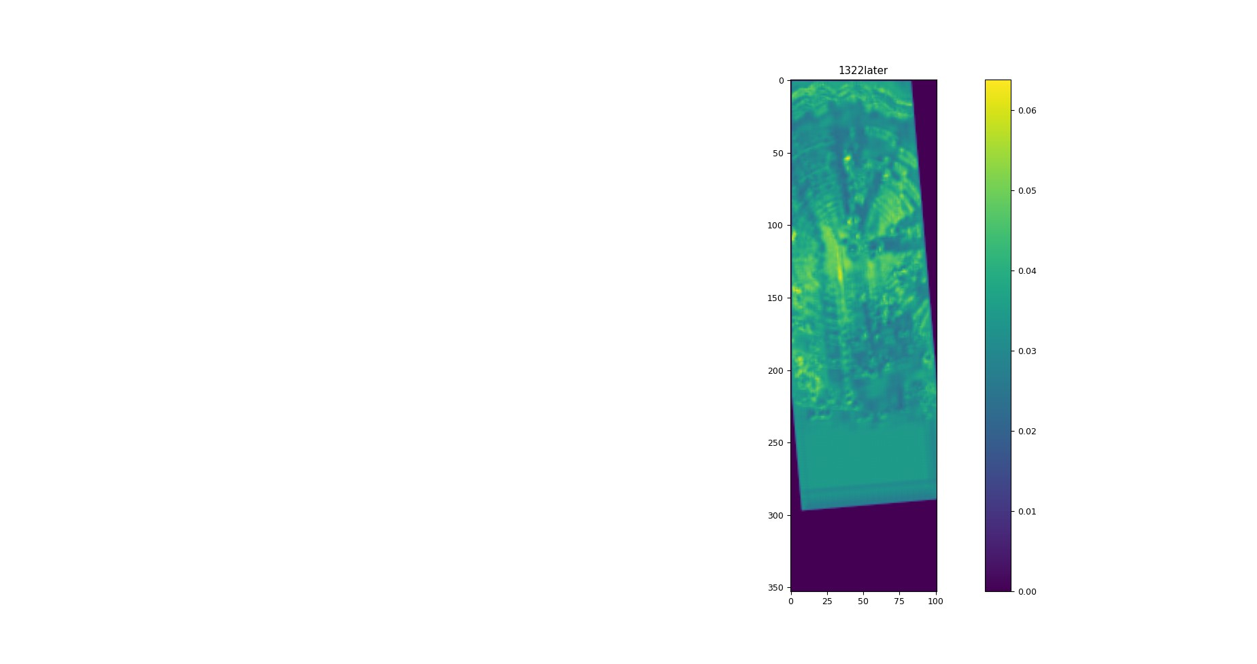
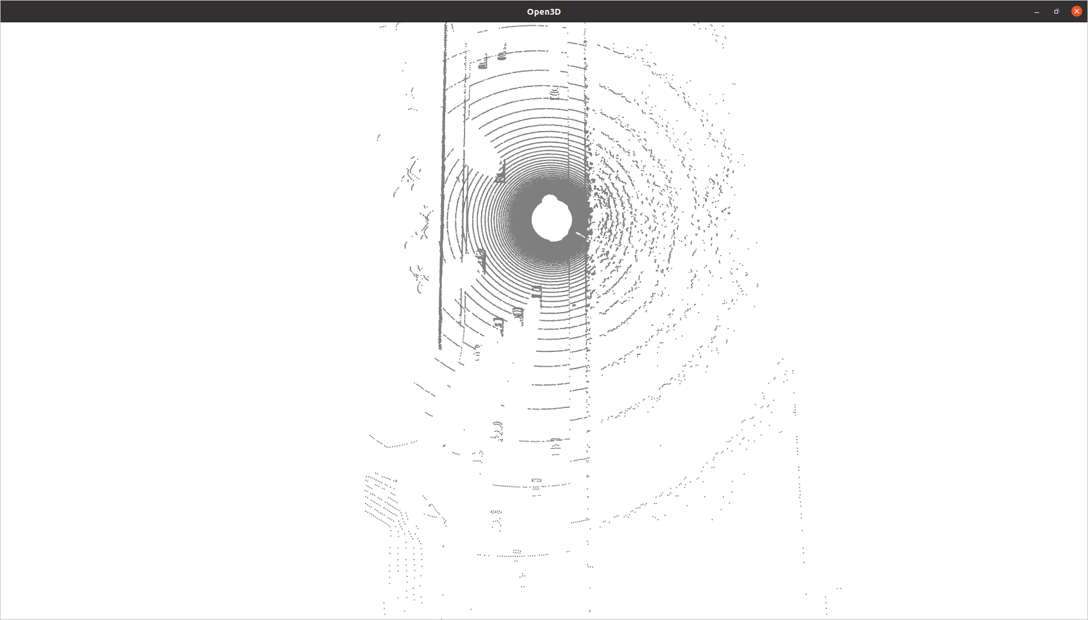
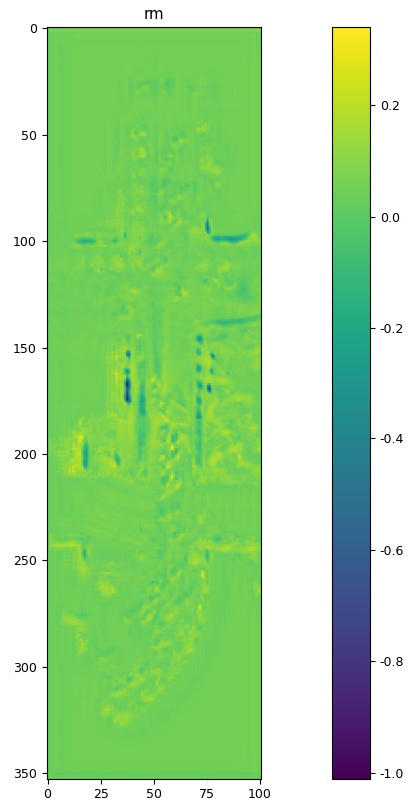
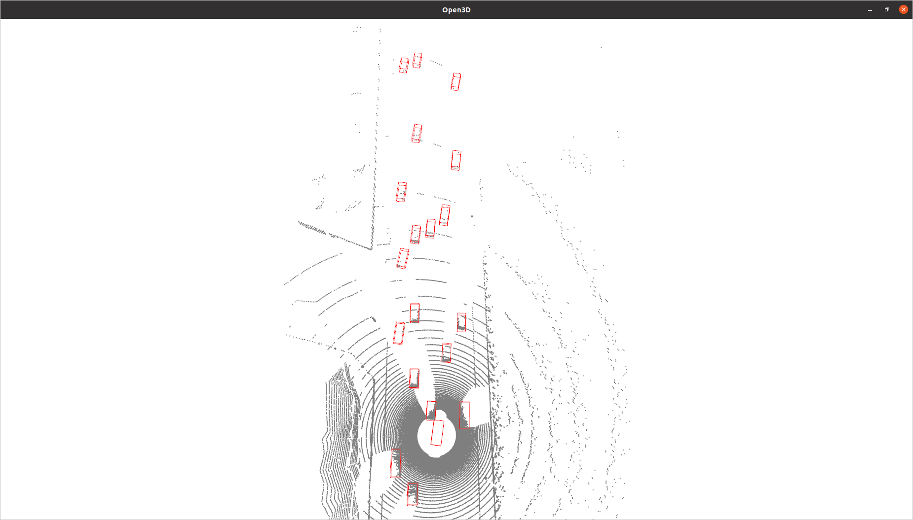

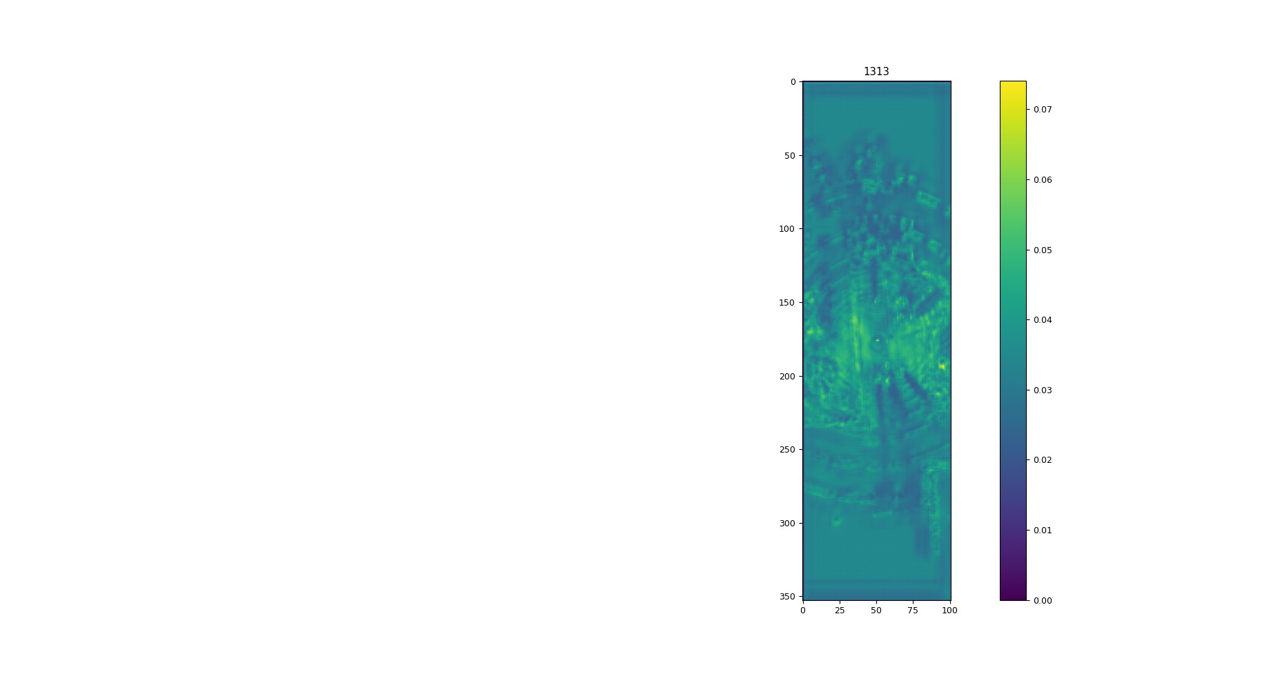

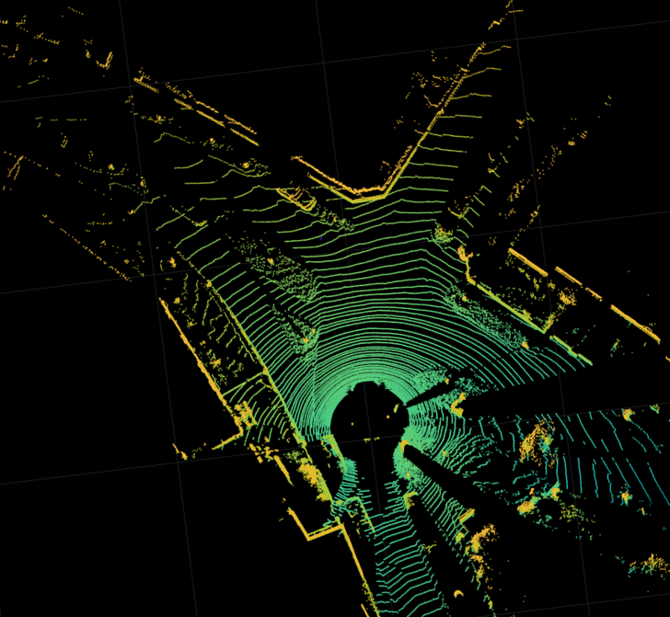
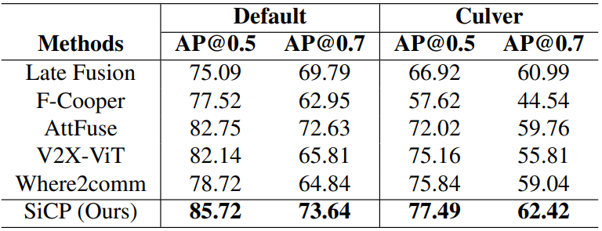
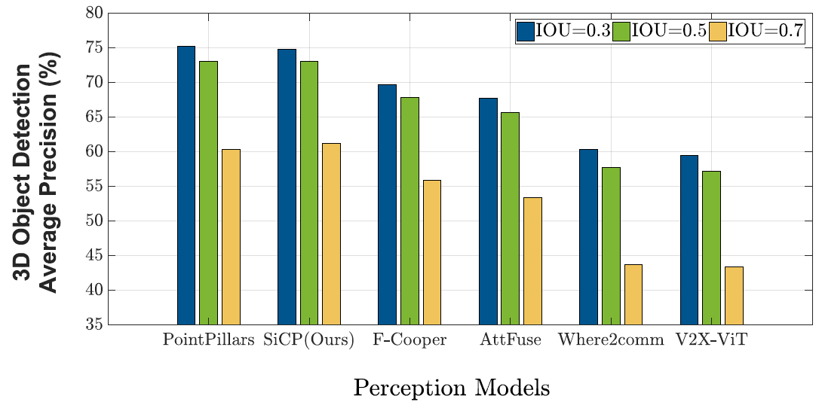
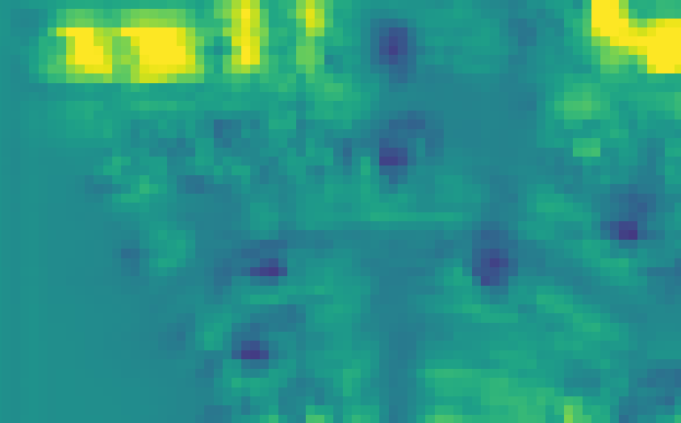
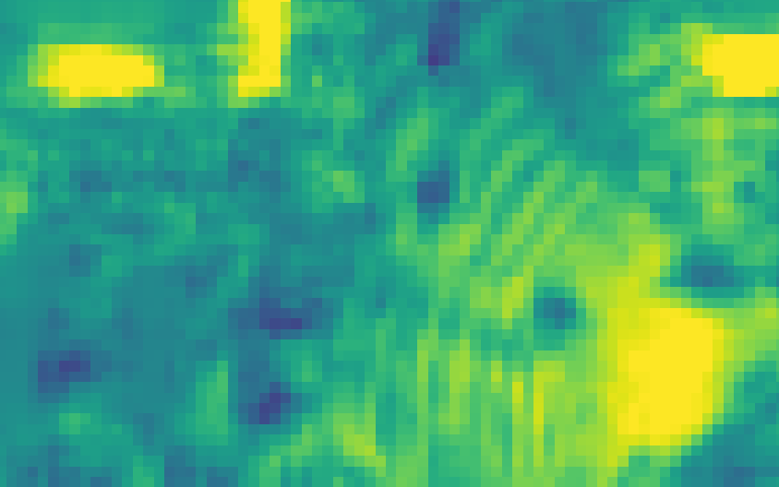
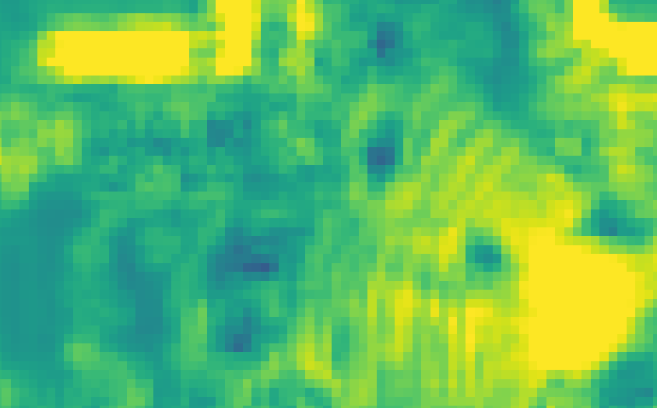
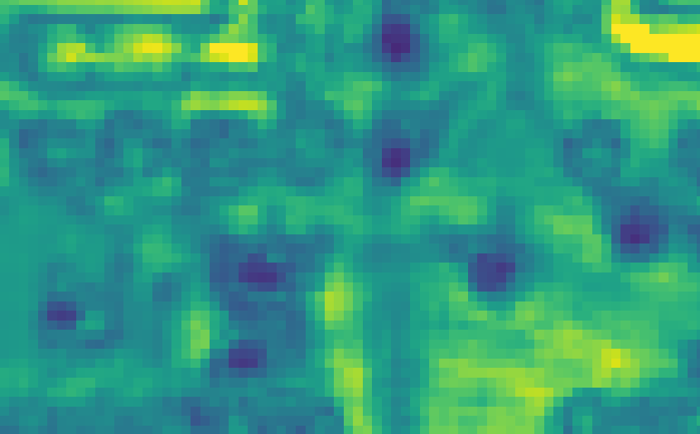
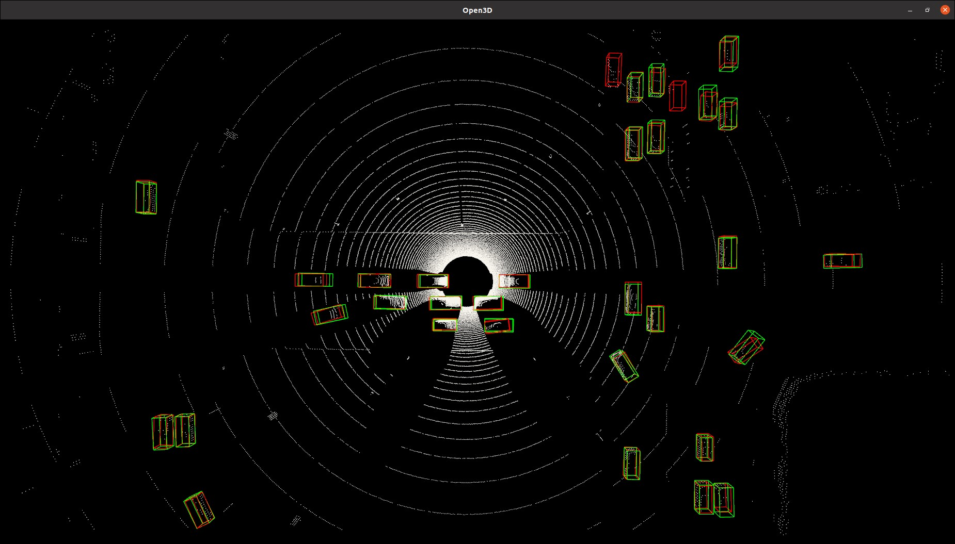
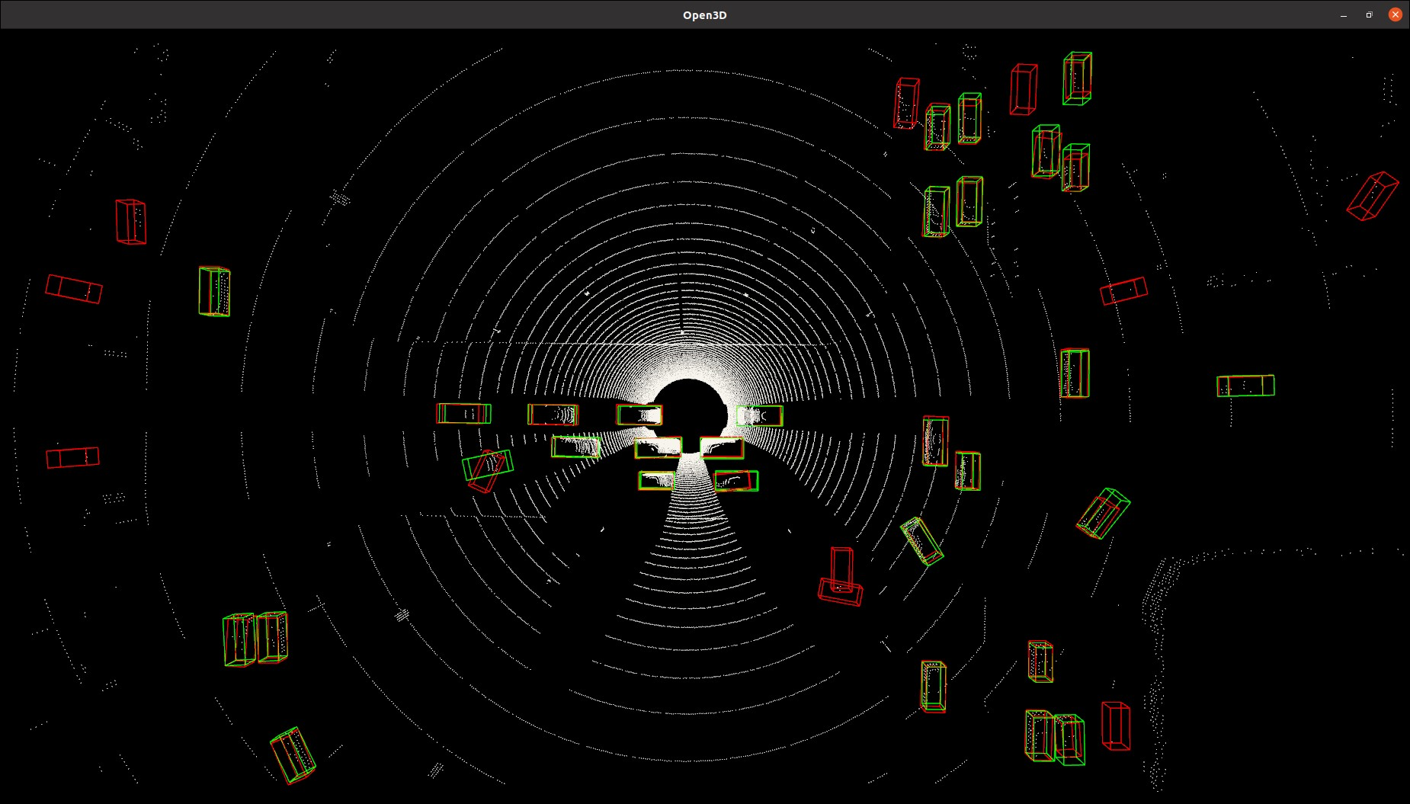
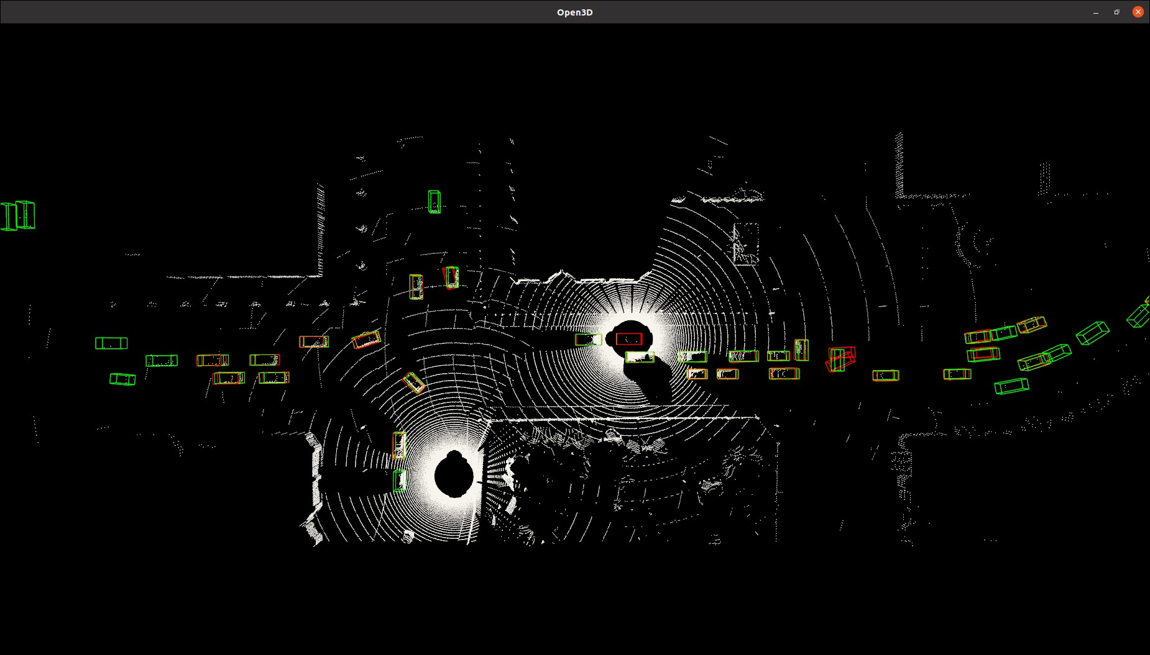
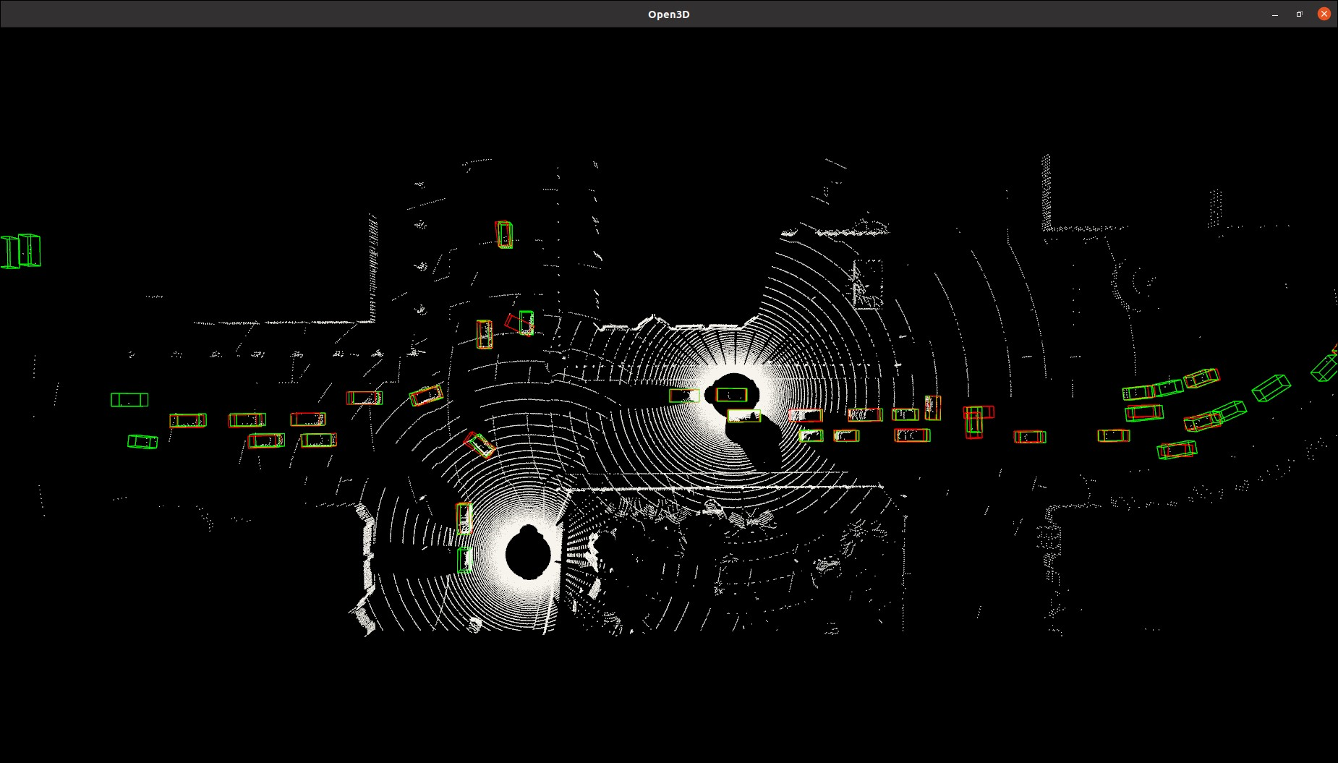
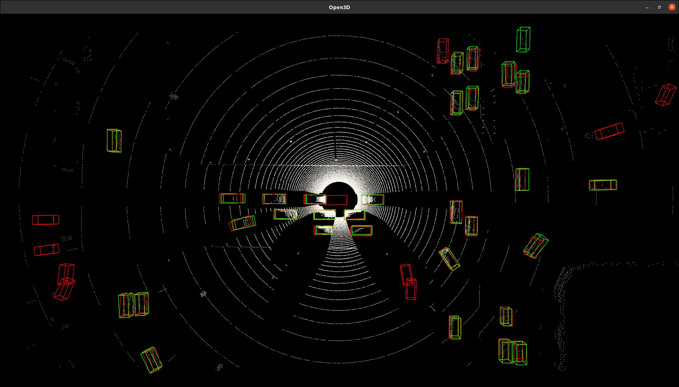
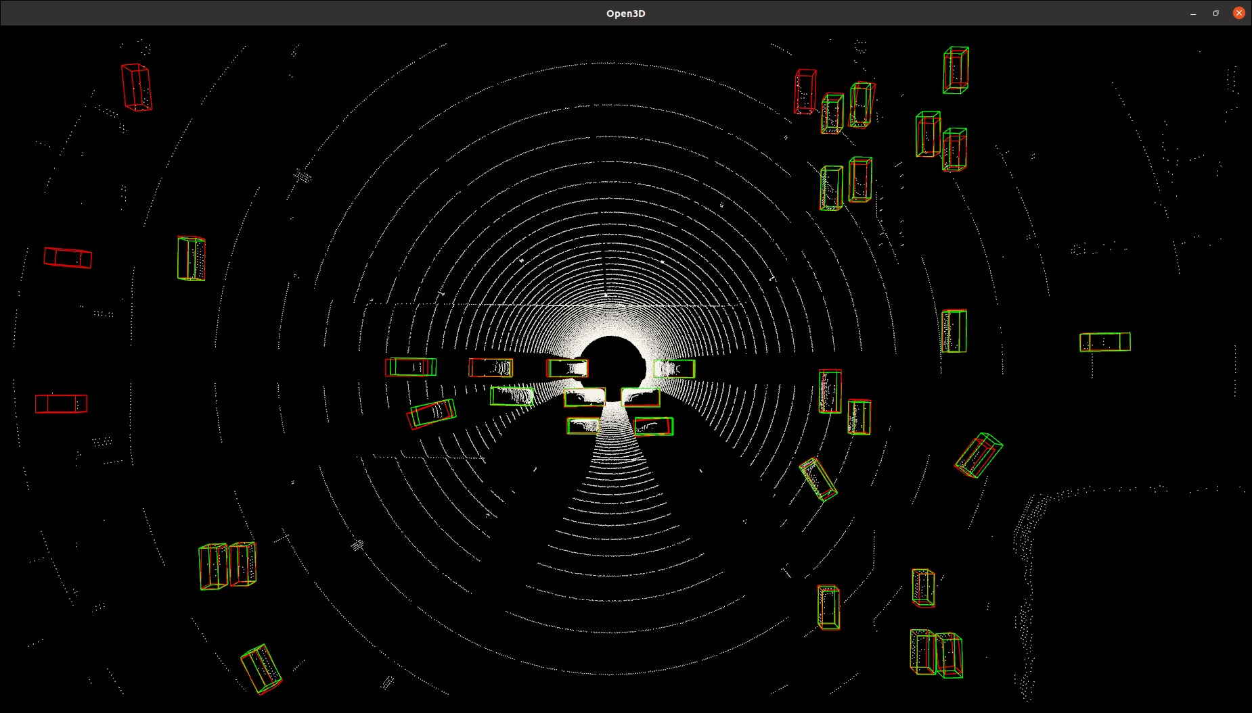
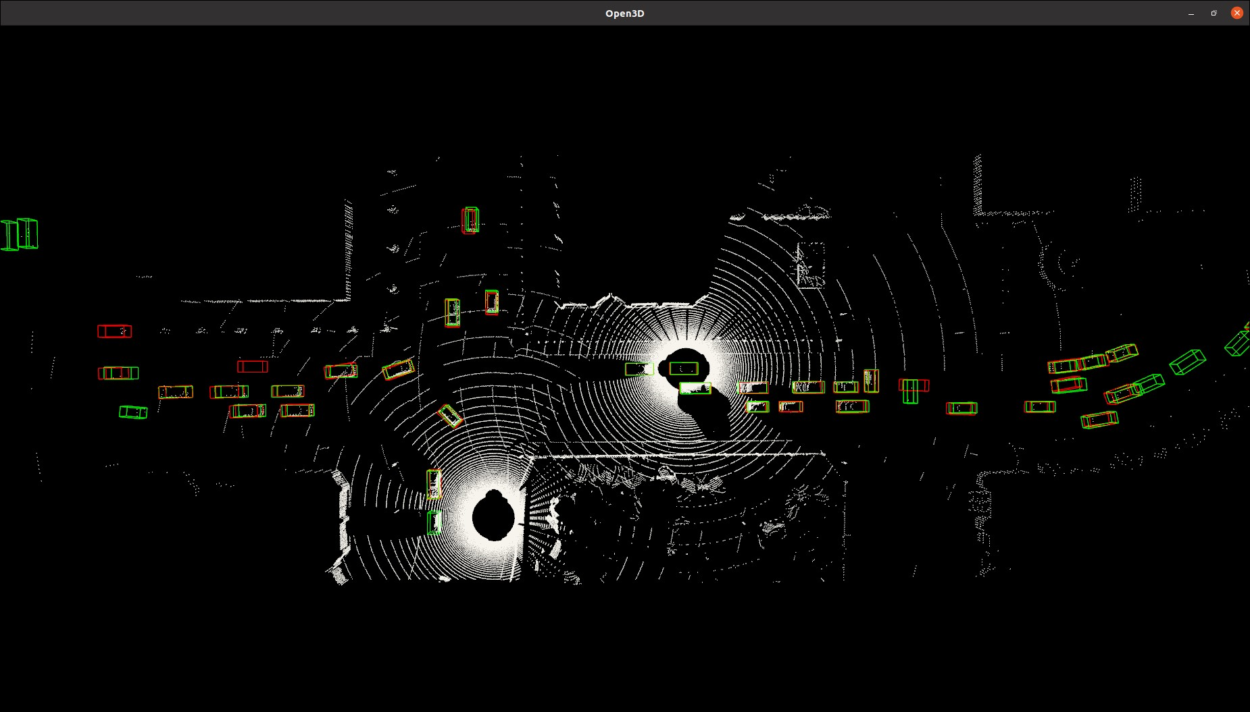
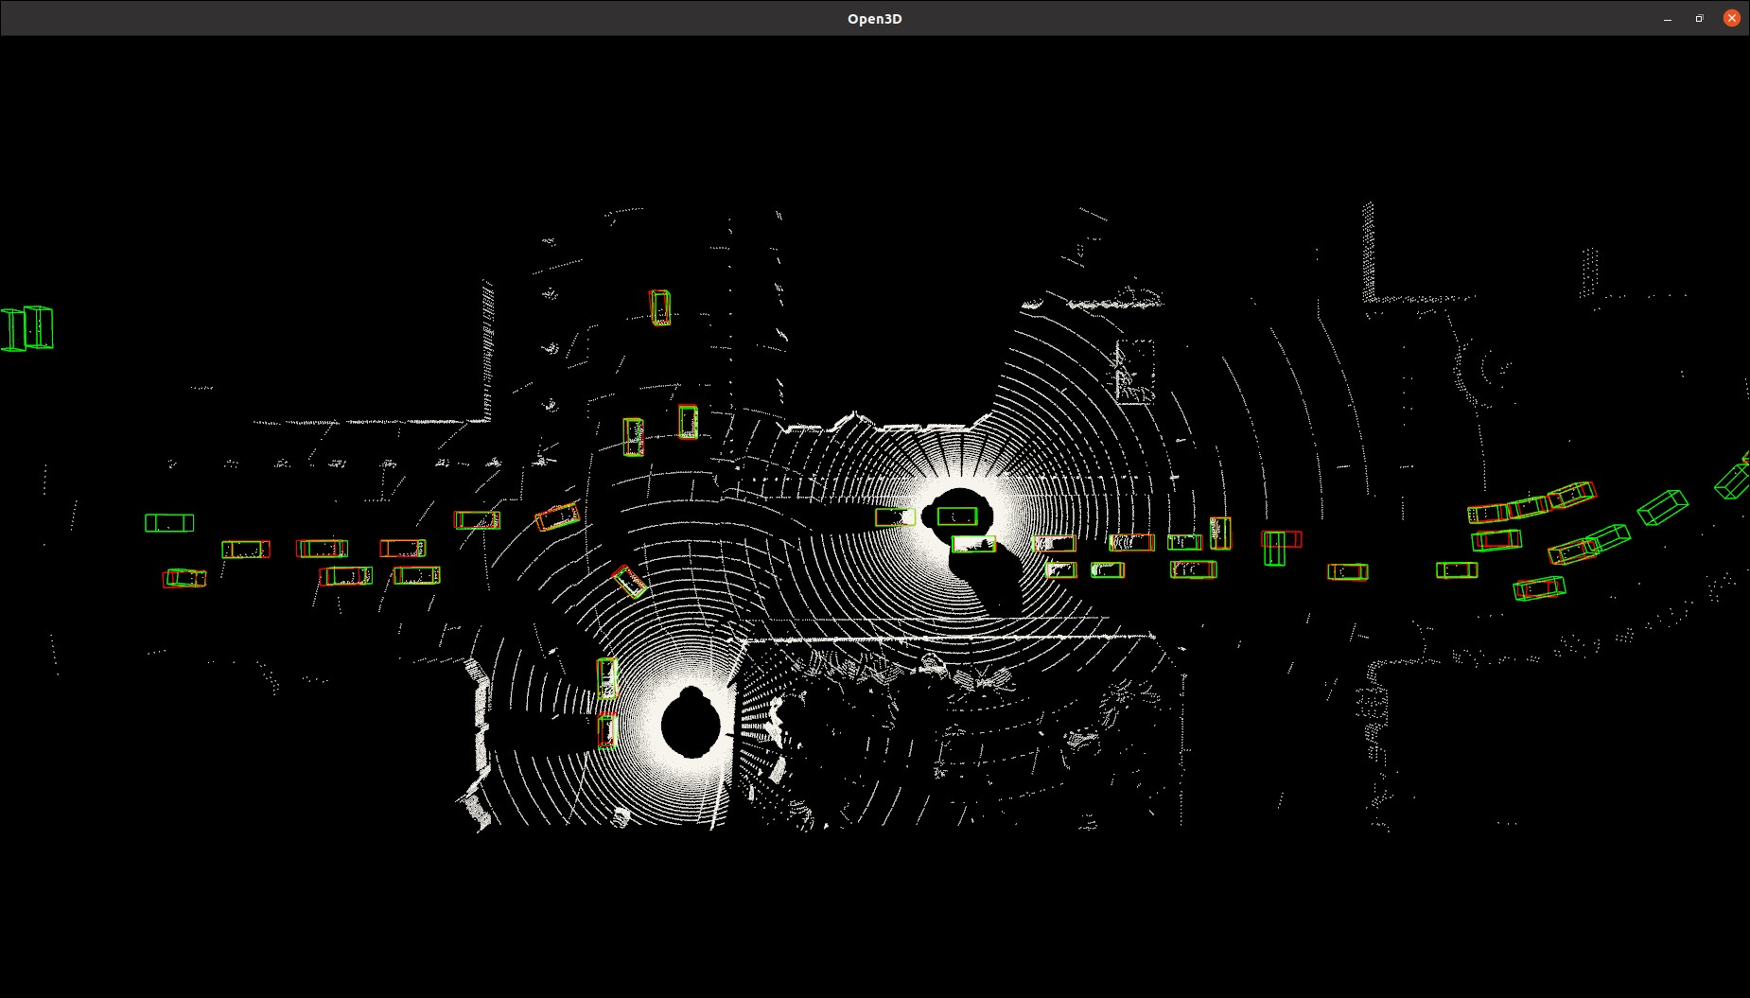



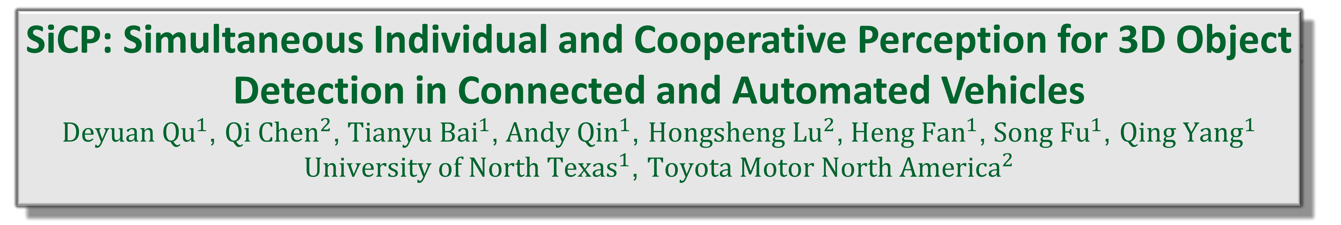
SiCP: Simultaneous Individual and Cooperative Perception for 3D Object Detection in Connected and Automated Vehicles
${Deyuan Qu}^{1}$, ${Qi Chen}^{2}$, ${Tianyu Bai}^{1}$, ${Andy Qin}^{1}$, ${Hongsheng Lu}^{2}$, ${Heng Fan}^{1}$, ${Song Fu}^{1}$, ${Qing Yang}^{1}$
${University of North Texas}^{1}$, ${\text{Toyota} \text{Motor} \text{North} \text{America}}^{2}$
Problem
Methods
Experiments
Individual Perception
An Overview of the SiCP Architecture
Comparison of Individual Perception
Cooperative Perception
Problem
The absence of feature maps shared from other vehicles can lead to a significant decline in object detection performance for cooperative perception models.
SiCP including a feature extractor, a feature processor(DP-Net), a detection head.
DP-Net contains two operations feature transform and feature fusion.
Comparison of Cooperative Perception
DP-Net Feature Fusion
Gradients Matter in Fusion
Qualitative Evaluations
Ego Feature
Sender Feature
Maxout Fusion
Ours
Complementary Feature Fusion
Proposed Solution
Simultaneous Individual and Cooperative Perception
We proposed a perception framework, SiCP (Simultaneous Individual and Cooperative Perception),to support individual and cooperative perception.
We designed a DP-Net (Dual-Perception Network), which is a lightweight and Plug-and-Play model, able to handle individual and cooperative perception tasks simultaneous.
$$F_{ego}$$
(a) Individual Perception
(b) Cooperative Perception
$$F_{j}^{′}$$
$$F_{ego}^{∗}$$
Conclusions
We first time recognize the significance of simultaneous individual and cooperative perception in connected and automated vehicles. And demonstrate the feasibility of handling both tasks within a single mode.
Our solution surpass the SOTA models in cooperative perception task, while achieving result on par with leading standalone 3D detection models in individual perception task.
$$F_{ego}:Ego vehicle^{′}s Feature$$
$$F_{j}^{′}:Sender vehicle^{′}s Feature$$
$$∅=Conv(F_{ego}||F_{j}^{′})∈ℝ^{H×W}$$
$$\overline{M}=∅ ⨁(σ(BN(Conv(δ(BN(Conv(∅)))))))∈ℝ^{H×W}$$
$$M:nomalize \overline{M} to get M∈[0,1]$$
$$F_{ego}^{∗}=Conv\left((M⊗F_{ego})||\left((1−M\right)⊗F_{j}^{′})\right)∈ℝ^{C×H×W}$$

